Slide 1


15 Minute Technical Topic Presentation
By Ryan J. Skelly 3/4/2021

Slide 2
01
Summary
02
Additional Details
03
04
Additional Information
Case Studies/ Examples
Overview
05
Controversial Issues

Slide 3
— Elon Musk, 2016
“You want to wake up in the morning and think the future is going to be great - and that’s what being a spacefaring civilization is all about. It’s about believing in the future and thinking that the future will be better than the past. And I can’t think of anything more exciting than going out there and being among the stars.”

Slide 4
Summary of Previously Covered Subject Matter
SpaceX
StarLink
Reusable Rockets
Aerospace manufacturer & Space Transportation services company
Based In Hawthorne, CA
Global Wireless Internet
Fully functional Beta
Falcon 9
Interplanetary Travel

Slide 5
Additional Details (Previously Asked Questions)
For Full Company Structure
Click Here!
How are they funded?
A: NASA, DoD, Other Private Entities
Plans For the Future?
A: TBC …
What is the company structure like?
A: Elon Musk: CEO, CTO
Gwynne Shotwell: Pres., COO
Hans Koenigsmann: VP

Slide 6
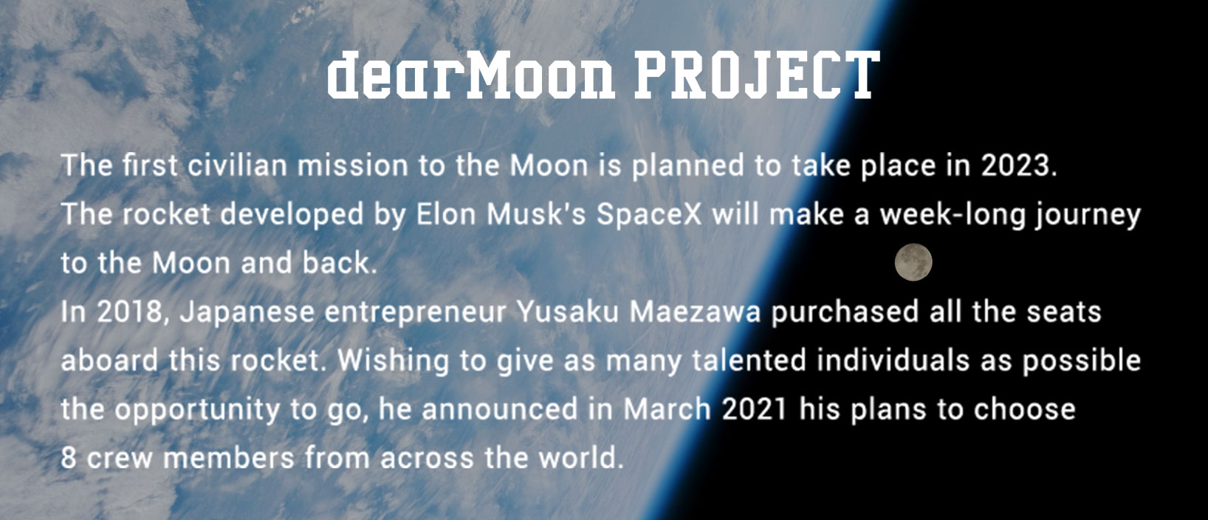
Additional Information
Upcoming SpaceX Launches
March 4, Starlink V1.0-L17
March 7, Starlink V1.0-L20
April 20, Dragon crew second launch
dearMoon Project:
Using SpaceX Starship

Slide 7
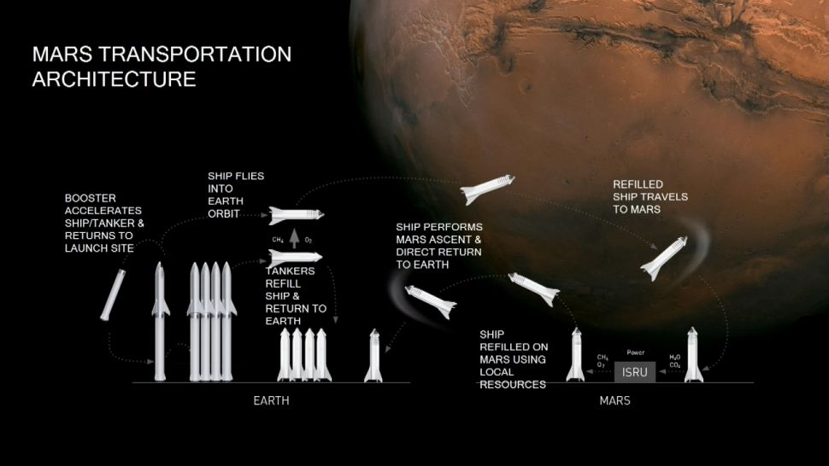
Additional Information Cont.
Far Future Plans :
MOON, 2022
MARS, 2024-2025
Other Advancement
NASA
China
UAE

Slide 8
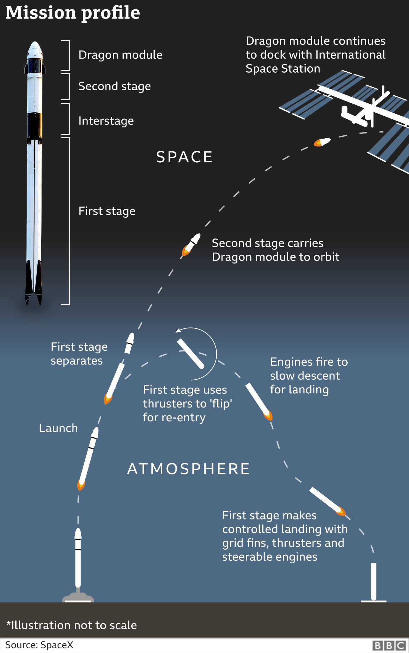
Case Study #1 : Falcon 9
HEIGHT | 70 m / 229.6 ft
DIAMETER | 3.7 m / 12 ft
MASS | 549,054 kg / 1,207,920 lb
PAYLOAD TO LEO | 22,800 kg / 50,265 lb
PAYLOAD TO GTO | 8,300 kg / 18,300 lb
PAYLOAD TO MARS | 4,020 kg / 8,860 lb
First Orbital Class Reusable Rocket
First Stage
Second Stage
Interstage
Payload

Slide 9
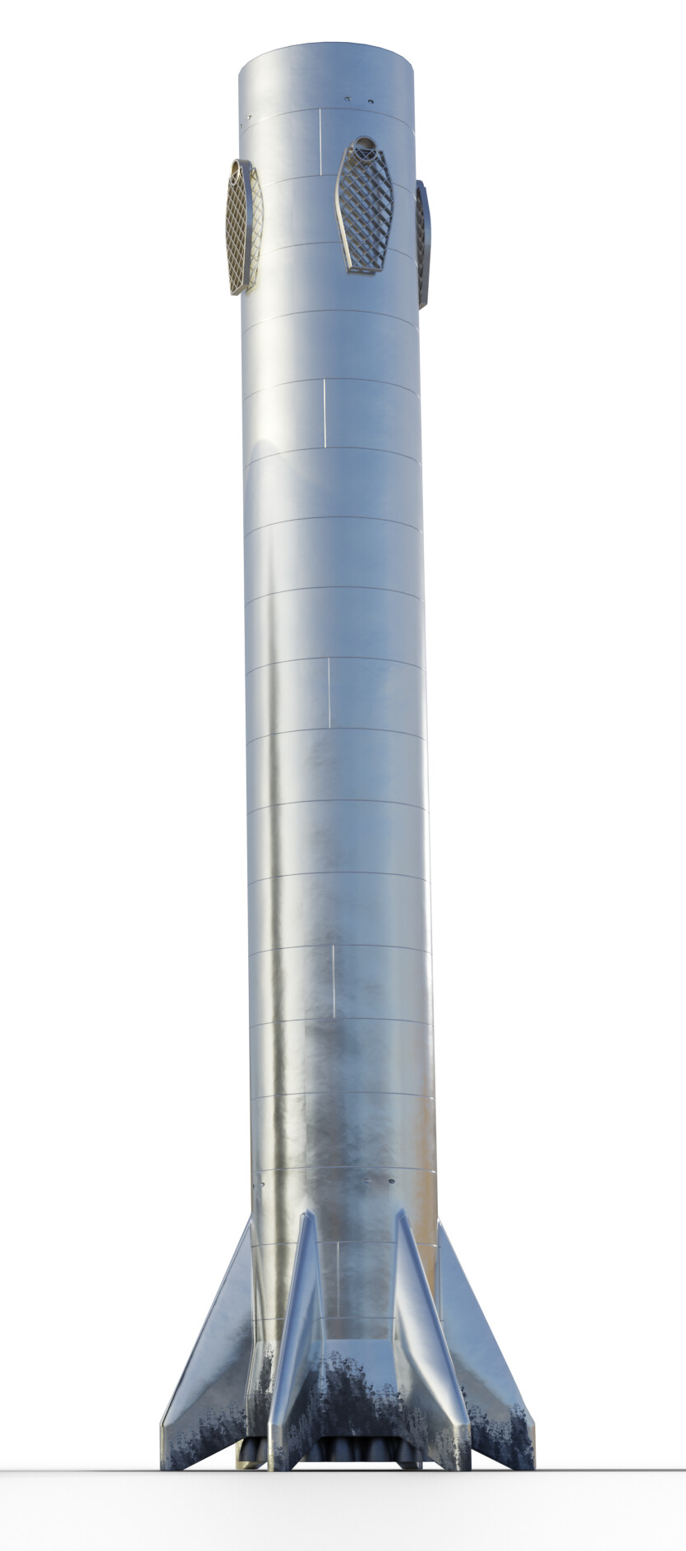
Case Study #2 : Starship & Super Heavy
HEIGHT | 120 m / 394 ft
DIAMETER | 9 m / 30 ft
PAYLOAD TO LEO | 100+ t / 220+ klb

Slide 10
Controversial Issues
Expansion
Danger
Competitors
Need for more land
Private
Jobs/Colonialism
Previous Fails
Future
Pregnancy
NASA’s SLS
Blue Orbit’s New Glenn
ULA’s Vulcan

Slide 11
Conclusion
Space Colonization is the Future
Ensures humanities existence
Still in development
Reusable Rockets > Rockets

Slide 12
Sources
Presentation template by Slidesgo
https://www.cnbc.com/2018/03/16/elon-musk-on-inspiration-and-success.html
https://spaceflightnow.com/launch-schedule/
https://theorg.com/org/spacex/org-chart
https://www.satelliteinternet.com/resources/starlink-beta-sign-up/
https://www.spacex.com/
https://www.starlink.com/
https://nypost.com/2021/03/03/yusaku-maezawa-seeks-eight-companions-for-spacex-trip-to-moon/
https://www.space.com/spacex-starship-first-mars-trip-2024
https://www.bbc.com/news/science-environment-52782483
https://www.click2houston.com/news/local/2021/03/03/spacexs-starship-sn10-expected-to-attempt-launch-this-week-in-boca-chica/
https://www.inverse.com/innovation/biggest-spacex-competitors/amp

Slide 13
Thanks!
Does anyone have any questions?
Rjs1070@wildcats.unh.edu

